Slide 1
FHIR for Architects (2 of 3)
Lloyd McKenzie
October 17, 2015

Slide 2
This presentation
Can be downloaded here:
http://gforge.hl7.org/svn/fhir/trunk/presentations/2015-12 Webinars/FHIR for Architects2.pptx
(use “anonymous” and email address)
Is licensed for use under the Creative Commons, specifically:
Creative Commons Attribution 3.0 Unported License
(Do with it as you wish – just give credit)

Slide 3


Questions?
(from yesterday ☺)

Slide 4
Agenda
Wednesday
Paradigms & Architecture approaches
Thursday
FHIR Features & Architecture decisions
Friday
Additional considerations, Profiles & Next steps
Each day = 1 hour presentation, 30 minutes for questions/discussion

Slide 5
FHIR Features
And the architecture decisions that go with them
Notes:
10:00

Slide 6
FHIR Features
Narrative
Extensions
Modifier Extensions
Versions
Tags
Syntaxes
Signatures
Reference Libraries
Conformance Resources
Bundles

Slide 7
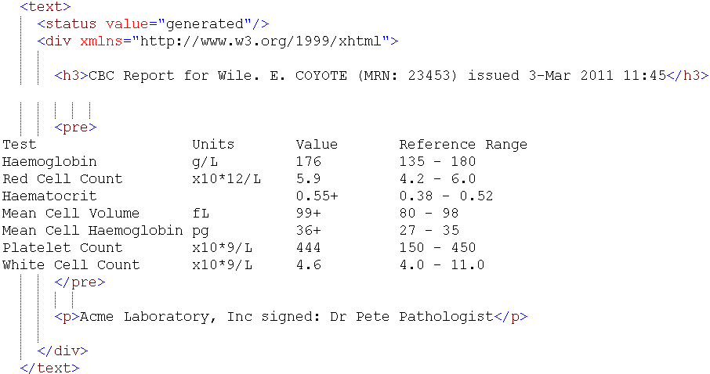
Narrative

Slide 8
Narrative
All resources are expected to have narrative except in narrow circumstances
May be generated or manually edited
Decisions
Should narrative be generated or human-entered?
Generated simplifies processing for receivers
Some text will need to human entered
In some cases, there may be minimal discrete data

Slide 9
Narrative decisions (cont’d)
If generated, which elements should be included? How should they be rendered?
all content needed for a human to understand the essential clinical and business information otherwise encoded within the resource
Will generally include modifierExtensions
May include other extensions
Best to seek clinician and other review of content, order of presentation & rendering
Consider that content may be rendered on mobile devices, so don’t get too fancy with markup

Slide 10
Narrative decisions (cont’d)
Should narrative be displayed to users?
Driven by Narrative.status
Business requirements (e.g. Document attestation) may drive need to render regardless
Notes:
If “generated” and system renders all core elements deemed “essential” human/business understanding, then no need to display narrative
If “extensions”, then can only suppress if all received extensions are understood and system renders all received core elements & extensions needed for human/business understanding
If “additional”, must always make narrative available to view

Slide 11
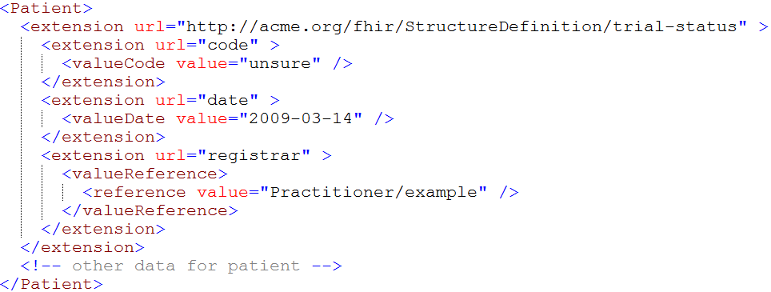
Extensions

Slide 12
Extensions (cont’d)
In FHIR, extensions are “normal”
Consequence of the 80% rule – keep the simple stuff simple
Extensions can exist anywhere
Yes, even inside boolean or date
Systems shouldn’t reject instances just because they contain unrecognized extensions

Slide 13
Extension decisions
Should unrecognized extensions be persisted? How?
Throwing away extensions = loss of potentially useful information to downstream systems
Therefore: Keep extensions if you can
Can capture them in a blob or a generic “slot” structure
Could, with location tagging, capture all “unknown” extensions for a resource in a single blob
Some legacy systems won’t be able to
When data is updated, some extensions must be dropped

Slide 14
Extension decisions (cont’d)
Should you display unrecognized extensions?
Extensions are identified by URL and have a known data type. Can resolve the URL, look up the name and display
Cost/benefit question – some extensions will have little value, others may have a lot
Might want to let users configure what gets displayed
If you do query, look at caching extension definitions to minimize performance issues

Slide 15
Extension decisions (cont’d)
What should you expose as an extension?
If data can be exposed using core structures, it should be
Can still send the same data in an extension
e.g. with more/less granularity, alternate coding, different data type
Look for existing extensions before defining your own
Extensions, if used, should be generic to encourage re-use (and thus broad recognition)
Extension should be on the element described by the extension

Slide 16
Extension decisions (cont’d)
Where to register extensions
Considerations:
What’s the scope? For local extensions, a local registry may make more sense
Is there a need for restricted access?
In general, broad registration = discoverable = broader uptake = broader recognition

Slide 17
Modifier Extensions
Also a core part of FHIR
Needed because some extensions can’t be safely ignored
Can’t compute on an element containing an unrecognized modifier extension. However, can:
Reject instance
Remove element containing unrecognized modifier extension
Just display narrative
Retrieve definition & seek human review

Slide 18
Modifier Extension decisions
When should you introduce them?
modifierExtension breaks interoperability so:
If you can accomplish your objective without one, do that
Consider a new resource or Basic
Could requirement be met by an element that doesn’t change other element interpretations?
Best used when already part of existing practice, but in too narrow an area to justify being part of core

Slide 19
Versions
33, v12 – 2012-12-04
/server.org/fhir/Patient/33/_history/12
33, v13 – 2012-12-05
/server.org/fhir/Patient/33/_history/13
33, v14 – 2012-12-08
/server.org/fhir/Patient/33/_history/14
33, v15 – 2012-12-09
/server.org/fhir/Patient/33/_history/15
/server.org/fhir/Patient/33
Notes:
* Note that you have two ways (at one moment) to reach version 15

Slide 20
Versions (cont’d)
FHIR allows versions to be tracked and retrieved
Do you want to support versioning?
May be difficult or impossible with some legacy data stores
Will still need to have unique version id (UUID, timestamp)
Provides useful collision-detection mechanism

Slide 21
Pop Quiz
Where can extensions appear?
When must a receiver process an extension?

Slide 22
Tags
Patient
MRN 22234
“Ewout Kramer”
30-11-1972
Amsterdam
Tag: http://example.org/fhir/Status#Test
Profile: http://hl7.org/fhir/Profile/us-core

Slide 23
Tags (cont’d)
Allow data to be attached to a resource “outside” the resource
Doesn’t break signature when added/changed
3 types:
Security
Profile
General (workflow, etc.)
Require business agreement
Can’t search by tag if authors don’t include them
And populate the same way . . .

Slide 24
Tag decisions
Tag vs. extension?
Use extension if:
Element is associated with the business object rather than electronic record
Part of attested content of resource
Should be included in narrative
Change should force new version

Slide 25
Syntaxes
Xml
JSON
<XXX xmlns=“urn:foo”>
<B a=“c” />
<C>One</C>
<C>Two</C>
<D>One</D>
<div>Not <b>so</b> easy</div>
</XXX>
{ “B”: { “a” : “c” },
“C”: [ “One”, “Two” ],
“D” : [ “One” ],
“div” : {
“text-before”:“Not ”,
b:“so”,
“text-after”:“easy”}
}
Notes:
We tried to find a way to automatically convert between the two so you could round-trip…
But discovered you’d need additional metadata to do that, or vendor-specific solutions
Decided not to introduce these: result was weird Xml or weird Json
Reference platform contains tools to interconvert (these use model definition metadata)

Slide 26
Syntaxes (cont’d)
Multiple representations
XML or JSON
RDF in progress
Reference implementations support both and conversion between
Maximizes interoperability
Inter-conversion isn’t (yet) robust enough for digital signatures (whitespace is an issue)

Slide 27
Syntax decisions
What syntax should be used when?
XML used to be required for servers
Now implementer’s choice
XML provides broader tools
XSLT, schema, XPath
JSON uses less bandwidth, more natural for mobile
RDF is niche
ideally, servers support all
maximum interoperability

Slide 28
Signatures
Three ways to digitally sign content
Sign bundle (Message or Document)
Sign resource version using Provenance resource
Limited to data integrity
Extension (for more complete signature)
No requirement to sign content
Signatures are just one mechanism of ensuring data integrity and/or non-repudiation
Signatures may not hold when converting between different syntaxes

Slide 29
Reference libraries
Currently 5:
C#, Java, Pascal (Delphi), Javascript, Swift
More to come?
Handle parsing, serialization, validation, etc.
Also open source servers, basic clients

Slide 30
Reference library decisions
Use a reference library vs. build your own?
Same criteria as any other “build vs. reuse”
Build costs more, but more tuned
At minimum, consult reference implementations to ensure you don’t miss nuances of specification
How often to update?
Reference libraries changing frequently
Will need to manage updates, especially given that custom code is likely resting on top

Slide 31
Conformance resources
Conformance, ValueSet, NamingSystem, ConceptMap & StructureDefinition
Provide “metadata” for operation of systems
Allow for “dynamic” configuration
E.g. Rather than having hard-coded rules for allowed codes, required elements, look it up in ValueSet or Profile resource
Can be hosted anywhere
Do you require a local copy for performance reasons? Perhaps synchronized copy via publish subscribe?

Slide 32
Conformance resources (cont’d)
Often arranged in cascading hierarchy
E.g. International value set, national value set, local value set
Need to consider timeframe and mechanism for propagating changes from higher levels in the hierarchy

Slide 33
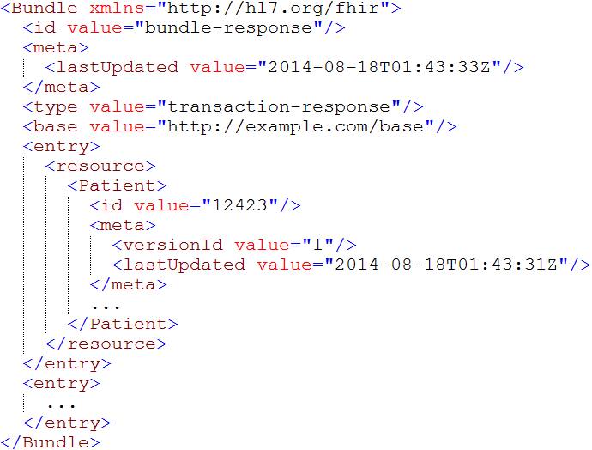
Bundles
Notes:
Note that the id of the resource is kept outside the resource itself
Bundle has many other meta-data items (not shown), which we will discuss later.

Slide 34
Bundles (cont’d)
Mechanism for messages, queries, transactions, query responses
In theory, could regenerate a document from constituent parts, but:
No clear boundary on what’s part of document vs. not
No way to guarantee order of entries
Thus: recommend storing as a binary

Slide 35
Bundle decisions
Ids within a bundle
Resources in bundles can be identified by UUID, server id or version-specific id
Server ids allow information in a document to be linked to existing resources.
Version ids should be used if data corresponds to a specific version (as opposed to filtered view)

Slide 36
Bundle decisions (cont’d)
Where’s the resource – bundled, contained, remote?
“contained” should only be used if resource can’t stand alone
Can’t exist if parent is removed
Not enough information to resolve
In bundle for document if part of narrative rendering rules or want part if signed content
In bundle for message if needed to process message and no separate query desired

Slide 37
Apply it
Which of the previous FHIR considerations are you going to pay particular attention to in your implementation?

Slide 38
Agenda
Wednesday
Paradigms & Architecture approaches
Thursday
FHIR Features & Architecture decisions
Friday
Additional considerations, Profiles & Next steps
Each day = 1 hour presentation, 30 minutes for questions/discussion

Slide 39
Questions?
http://hl7.org/fhir lmckenzie@gevity.com

